Slide 1
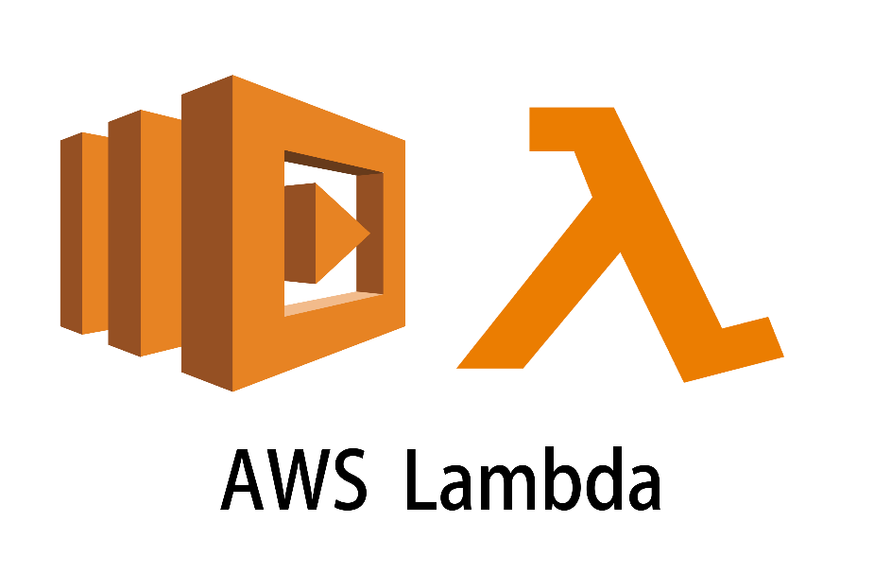

Slide 2

Topics
Brief History Of cloud
What is Lambda
Traditional Vs Serverless Architecture
Languages Support by Lambda
Lambda Pricing
Why is lambda
Exam Tips

Slide 3
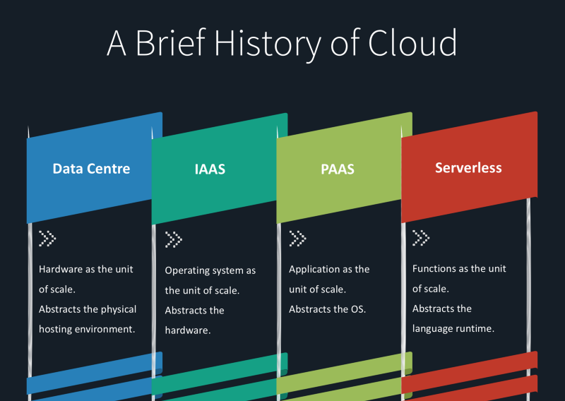
Brief History Of cloud

Slide 4

Brief History Of cloud

Slide 5

What is Lambda?
AWS lambda is a compute service where you can upload your code and create lambda functions
AWS lambda takes care of provisioning and managing the servers that you use to run the code.
You don't have to worry about operating systems, patching, scaling, etc
Lambda is the Ultimate Abstraction Layer
Data Centers
Hardware
Assembly Code/Protocols
High Level Language
Operating System
Application Layer/AWS APIs
AWS Lambda

Slide 6
Use lambda :
As an event-driven compute service where AWS lambda runs your code in response to events. These events could be changes to data in an Amazon S3 bucket or an Amazon dynamo-db table
As a compute service to run your code in response to HTTP requests using Amazon's API gateway or API calls made using the AWS SDKs.

Slide 7





Amazon Lambda
Let’s party

Slide 8



Amazon Lambda

Slide 9




Traditional Vs Serverless Architecture
Traditional Architecture
Serverless Architecture

Slide 10
Languages Support by Lambda
Node JS
Java
Python
C#
PowerShell

Slide 11

Lambda Pricing
Number of requests
First 1 million requests are free. $0.20 per 1 million requests
Duration
Duration is calculated from the time your code begins executing until it return or otherwise terminated, rounded up the nearest 100ms.
The price depends on the amount of memory you allocated to your function.
You are charged $0.00001667 for every GB/Second used

Slide 12

Why is lambda
No servers!
No system administrators
No patching operating system
No antivirus
Continuously scales.
Super, Super cheap.

Slide 13
Exam Tips:
Lambda scales out (not up) automatically
Lambda functions are independent, 1 event = 1 function
Lambda is serverless
Lambda functions can trigger other lambda functions, 1 event can = X number of functions if functions are triggering other functions.
Architectures can get extremely complicated; AWS X-ray service allows you to debug what is happening.
Lambda can do things globally; you can use it to back up S3 buckets to another S3 bucket
Know your triggers

Slide 14
Thank you

